Slide 1
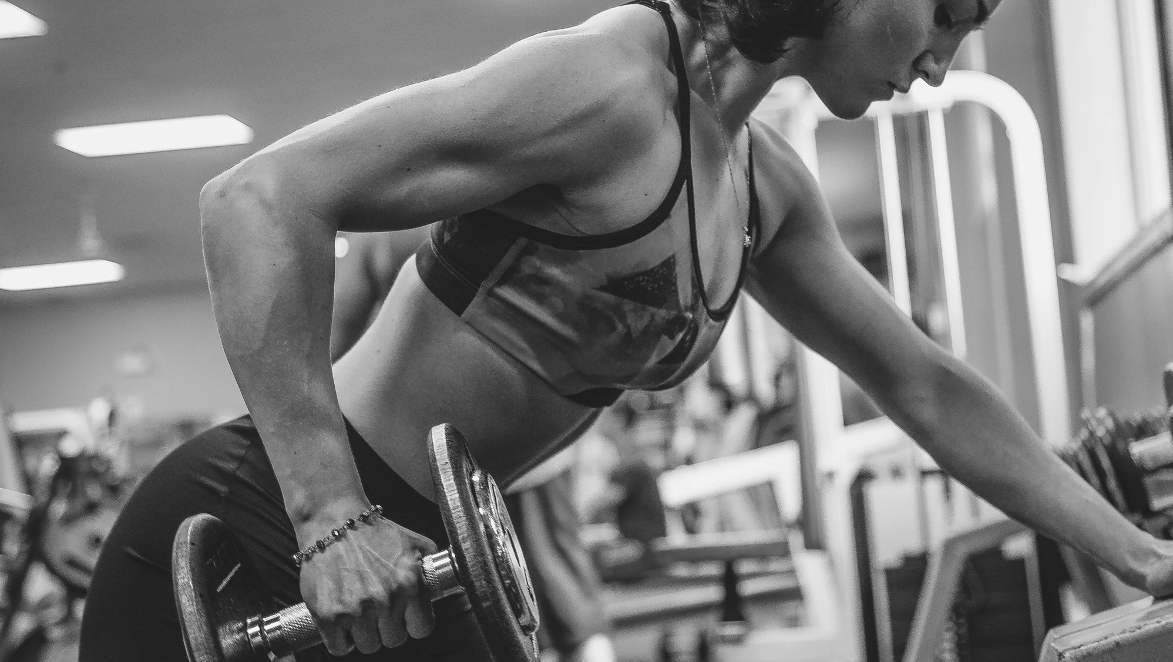


Black Friday Marketing Guide
A workbook for increasing new joins and retention rates this holiday season
*To view video content, please "enable editing" and "enable content"

Slide 2
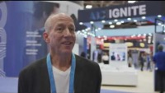
Scott Gillespie
President, Saco Sport & Fitness
*To view video content, please "enable editing" and "enable content"

Slide 3
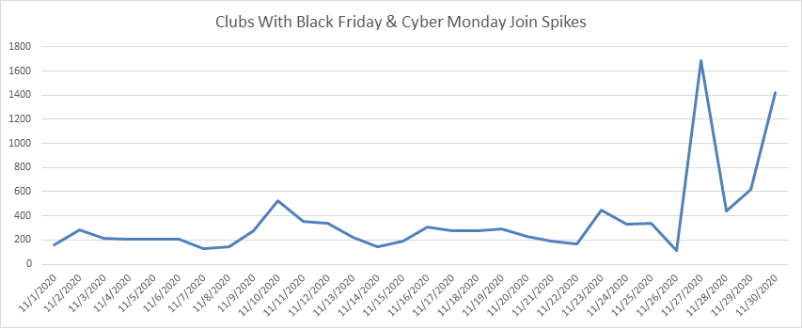
Last year clubs with a dedicated marketing effort for Black Friday and Cyber Monday saw a noticeable increase in their membership joins.
Data from ABC portfolio, November 2020

Slide 4
This year is set up to be an even greater opportunity for club owners and operators. Members are beginning to feel more confident on their return to the gym.
”49% of consumers state they plan to rejoin within the next 6 to twelve months”
As of June 2021, from Part I of our Fitness Consumer Research Report
https://abcfitness.com/resources/ebooks-and-articles/fitness-consumer-report-2021/!

Slide 5
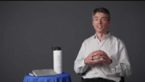
Mark Harrington, Jr
President, Healthworks and Republic Fitness

Slide 6
Prepare for Black Friday
In three easy steps:
Decide on Your Unique Offer
Get Your Team Ready
Make Members Aware

Slide 7
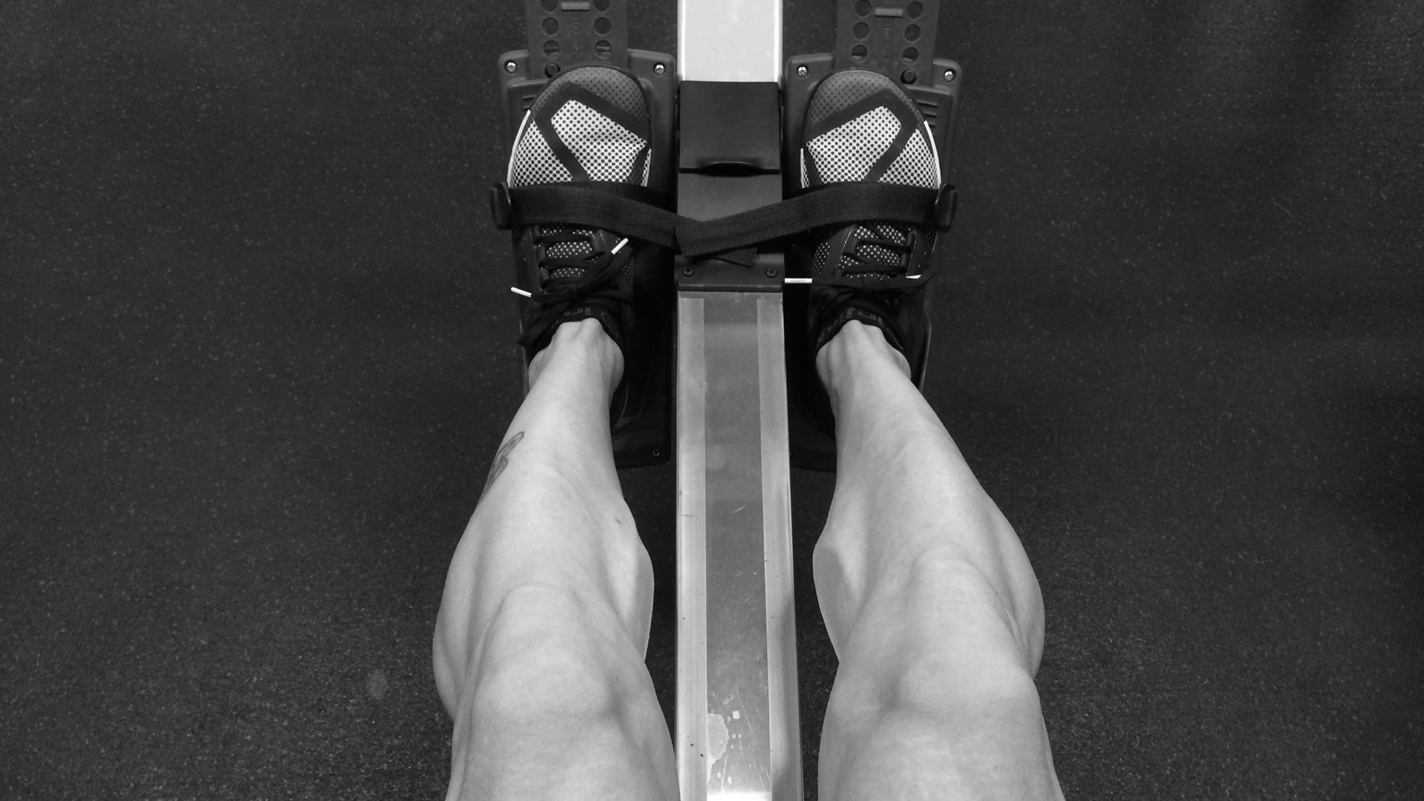
What unique opportunities can my club offer on Black Friday to our current members and bring in new?

Slide 8
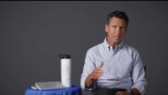
Ralph Rajs
Chief Operating Officer, Forma Gym

Slide 9
Sell more with bundles
2021 Black Friday Ideas

Slide 10
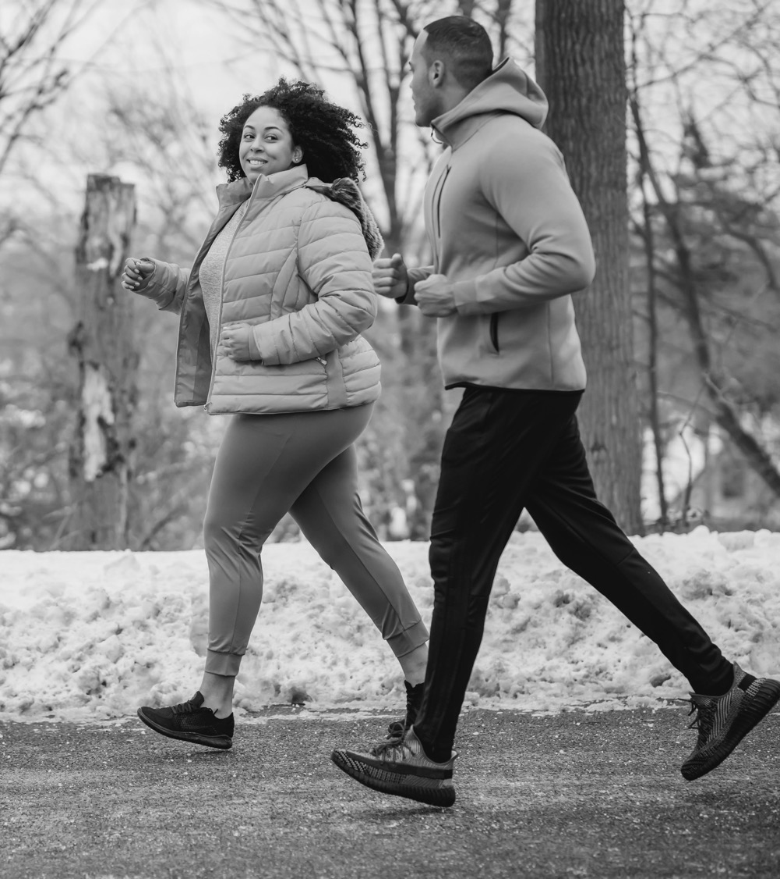
Sellable Bundle Ideas for
Black Friday or Cyber Monday 2021
The Kick-Starter
Include:
6-weeks of Personal Training
At-home programming
Cardio routine and group fitness recommendations based on goals
Think about offering:
Additional upgrades to nutritional consult/assistance
Nutritional supplements you offer in-gym
Set of resistance bands
Sweat towel

Slide 11
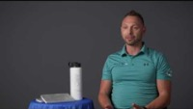
Landon Burningham
Founder, President and CEO of Physiq Fitness

Slide 12
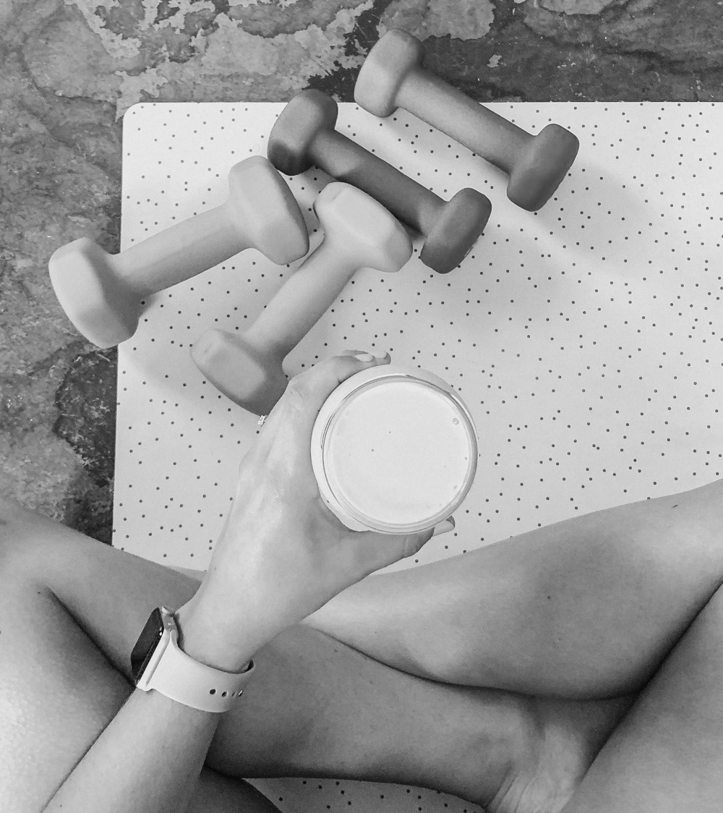
Sellable Bundle Ideas for
Black Friday or Cyber Monday 2021
The Wellness Explorer
Include:
Nutrition programming
InBody/total body scans
Blood pressure or heart rate monitoring
Weekly group fitness and cardio recommendations
Weekly check-ins to review metrics such as resting heart rate, cardio fitness level, heart rate, etc. to adjust plan as needed
Think about offering:
Yoga mat
Nutritional supplements you offer in-gym
Journal

Slide 13
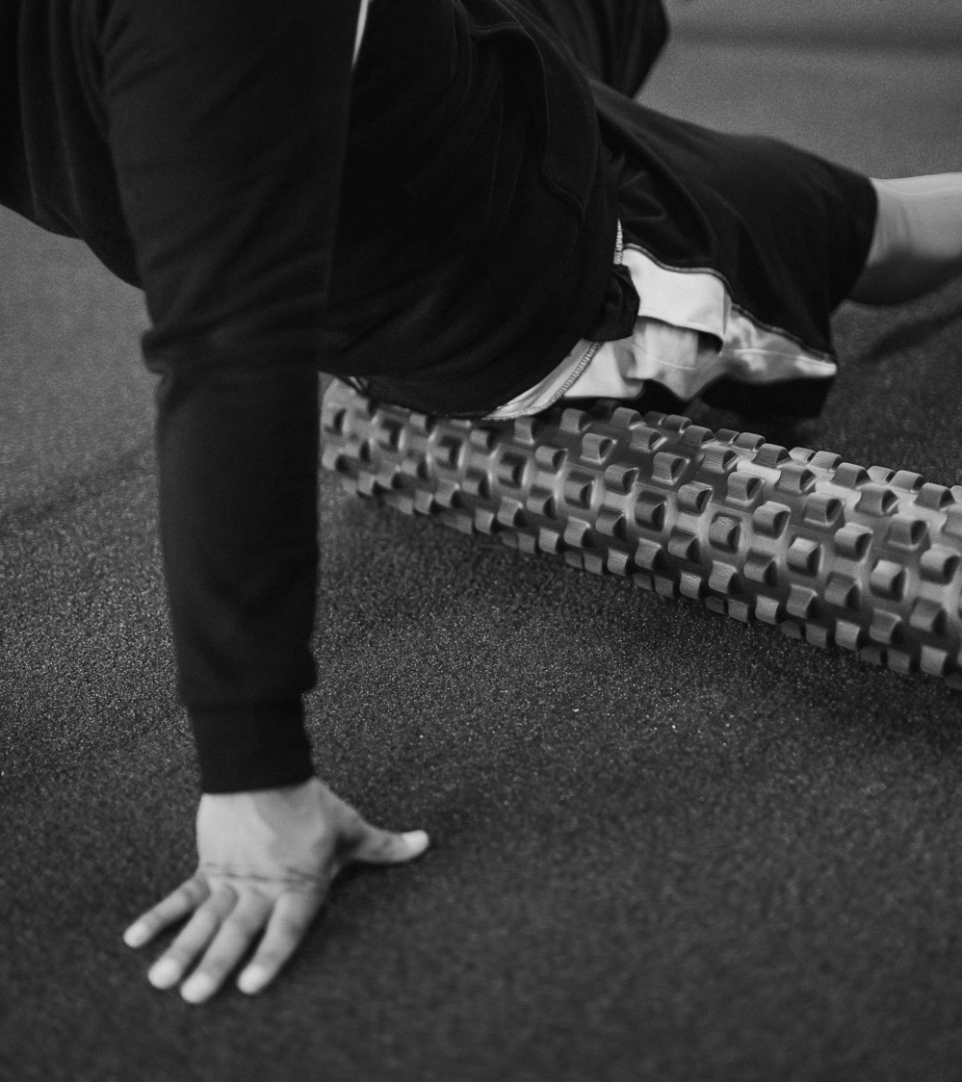
The Mobility and Movement
Include:
4 weeks of mobility-focused Personal Training
1 yoga class/week
Educational foam-roller session to improve mobility
Think about offering:
Yoga mat
Lacrosse ball/foam roller to bring home
Branded water bottle

Slide 14
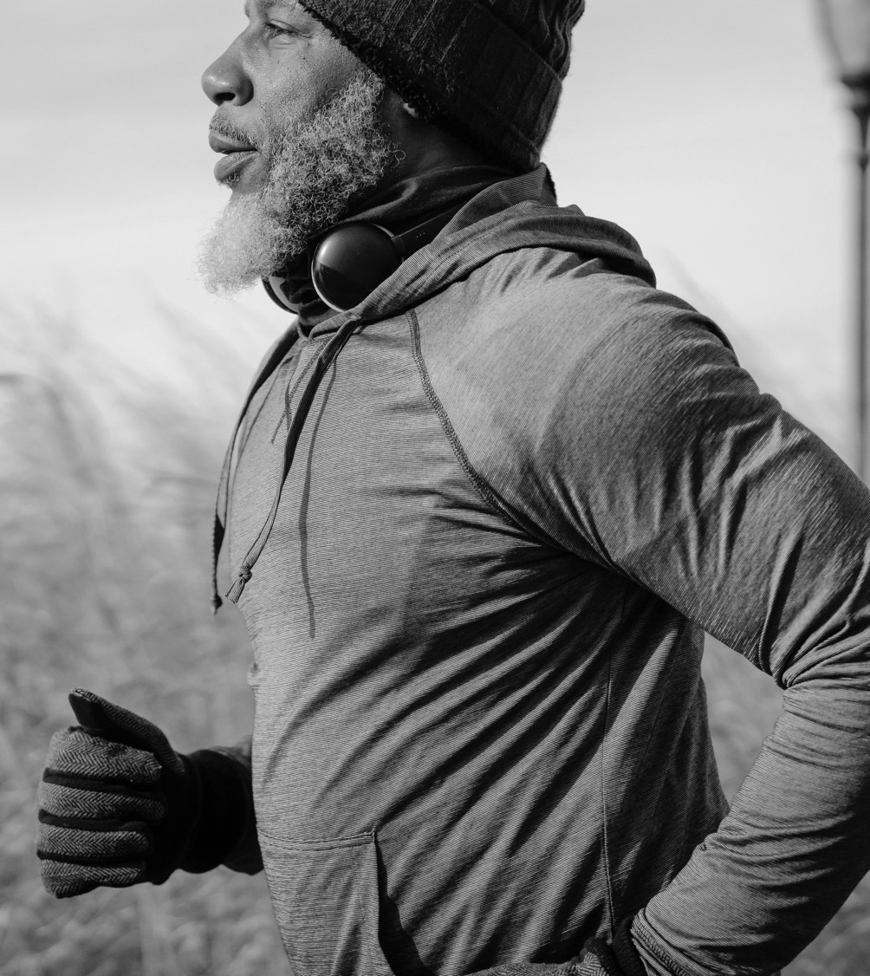
Sellable Bundle Ideas for
Black Friday or Cyber Monday 2021
The Weight-loss Warrior
Include:
6-week weight loss challenge
Unlimited group fitness classes
1/wk. check-in with Personal Trainer
1 complimentary nutrition consult
Think about offering:
Branded water bottle
Branded sweat towel
Referral bonuses for bringing friends

Slide 15
Map out your Bundle Idea
What is your bundle theme?
What services can you offer to assist your member in reaching the bundle’s goal?
Are there any take home items to help the member on their journey?

Slide 16
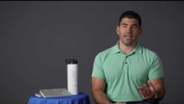
Assaf Gal
Franchisee Owner, Crunch Fitness

Slide 17
Prepare for Black Friday
In three easy steps:
Decide on Your Unique Offer
Get Your Team Ready
Make Members Aware

Slide 18
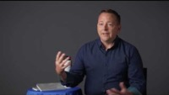
Trey McClain
Chief Revenue Officer, Bob’s Gym

Slide 19
Get your team ready for your club’s Black Friday promotion.
Host an internal kick-off
Assign clear roles and responsibilities
Set specific KPIs for the promotion

Slide 20
Map Out Your Team Meeting
What date are you scheduling the kickoff meeting with your team?
Make a list of your team members and their roles and responsibilities:
  ________________
  ________________
What are your Key Performance Indicators (KPIs) for this promotion?
  ___ Bundles sold
  ___ Trials
  ___ Membership sold
  ___ Personal training sold
  ___ Referrals
  _____________________
  _____________________
  _____________________

Slide 21
Prepare for Black Friday
In three easy steps:
Decide on Your Unique Offer
Get Your Team Ready
Make Members Aware

Slide 22
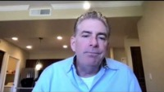
Bill McBride
Co-Founder and President & CEO, Active Wellness

Slide 23
Reach members where they are with a variety of marketing and communication methods in your plan.
Multichannel approach: web, text, phone, email, in-gym, out in the community
  Download 17 email and text templates to automate your gym lead management
  Learn how to maximize your gym marketing budget for the New Year Rush in this webinar

Slide 24
Get out in your community with guerilla marketing, which you may also know as “pavement” marketing.
Guerilla Marketing Activities:
  Passing out flyers and/or promotional items
  Hosting a free pop-up class inside your gym or in a public space
  Host a Q&A about the promotion at a popular spot in your community (smoothie shop, healthy grocery store, etc.)
  Create chalk art on the sidewalk with promotion details
  Hand out stickers, free t-shirts, water bottles, etc.
  Work with other brands to surprise and delight / cross-promote
  Invite employees or teams in from offices nearby to do a mid-day group fitness class (at a private time that doesn’t overlap with your existing class schedule)
During these interactions, focus on making connections and building genuine relationships!

Slide 25
Map Out Your Marketing + Communications Plan
What channels do you plan to use?
  Website
  Text Message
  Phone Calls
  Emails
  In-gym
  In the Community
What is your message?
What is your frequency?
Where are you going to order your print materials?
Will there be a social media component?

Slide 26
These are all things anyone can do on their own.
But with ABC IGNITE, you can:
- Setup and monitor health habits and challenges
- Track nutrition with Meal Tracker
- Allow members to schedule time with a personal trainer
- Create automated messaging campaigns to upsell offers
- Track discounts and membership offers
Connect with the team to learn how to jumpstart your club’s 2022 goals with ABC Fitness Solutions.

Slide 27
Prepare for Black Friday
In three easy steps:
Decide on Your Unique Offer
Get Your Team Ready
Make Members Aware

Slide 28

